Slide 1
CASE PRESENTATION
DR.MINI GOPAL
KANYAKUMARI IVF
DR.GOPALA PILLAIS HOSPITAL
NAGERCOIL

Slide 2
30 Years Female
SO + IUI Pregnancy
Serum βHCG – 520 mIU/ml
EVS – 6 wks GS in Anterior Myometrium in LUS
YS+ ,FP+, Fh+
Endometrial cavity empty

Slide 5
Past H / -
Primary Infertility of 3 yrs
M/H – Irregular Cycles
Hysterolaparoscopy
Single Cavity
Rt osteum obscured
Lt osteum clear
Uterus bulky adenomyotic
Seedling myoma anterior left cauterised
Rt adnexa absent
Lt ovarian & POD adhesions released
Lt tube patent

Slide 8
Treatment
Conservative – S: β HCG - <1000 mIU/ml
Unruptured, stable patient
EVUSGA and Mtx injection

Slide 10
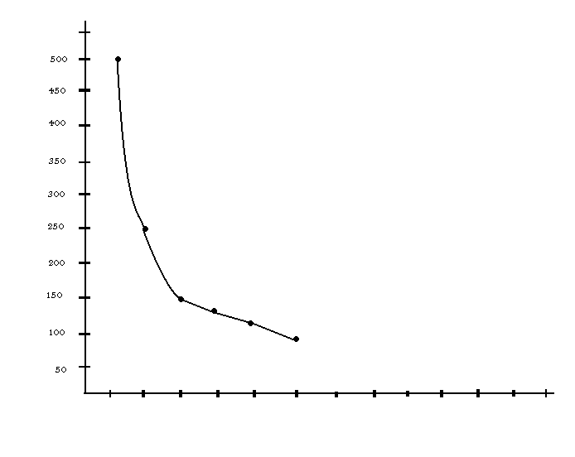
Follow up
β HCG Regression Curve
EVUSGA
16/07 26/07 29/07 30/07 01/08 08/08 16/8 24/8 30/8

Slide 13
Intra Myometrial Pregnancy
Rarest ectopic pregnancy
Difficult diagnosis
GS within uterine wall
Separate from uterine cavity & F : tube

Slide 14
Causes
Previous uterine trauma
Recurrent curettage
Previous caesarean section
Myomectomy
Adenomyosis
UAE for fibroids

Slide 15
Symptoms & signs
+ ve pregnancy test
Abdominal pain
Irregular bleeding PV

Slide 16
DIAGNOSIS
ENDO VAGINAL USG
MRI

Slide 17
Differential Diagnosis
Pregnancy in uterine diverticulum
Degenerating Myoma

Slide 18
Complications
Uterine rupture
Placenta accreta
External migration
Maternal mortality – 2.5 %

Slide 19
Treatment
Conservative – Local MT x
Systemic MT x
Surgical - Enucleation
Laparoscopic
Laparotomy

Slide 20
Conclusion
Early Diagnosis
Fertility Sparing

